Slide 1
Mac Office 2016 Activation Troubleshooting
TEIS Digital Workplace
Document Version 1.0

Slide 2
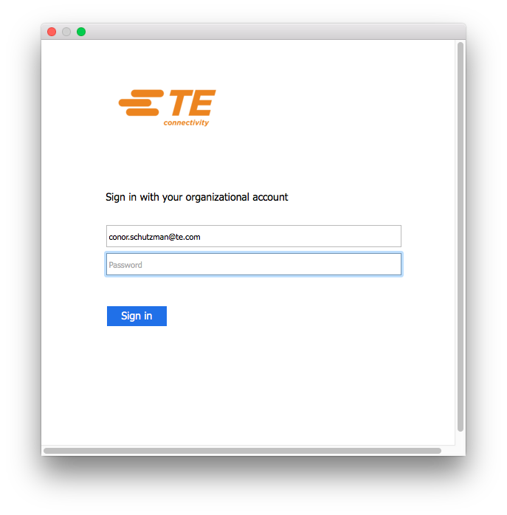
Symptom: Unable to Activate Office
Microsoft Outlook is unable to send or receive email, while Outlook Web Access continues to function without issue. Word, Excel, PowerPoint will only open documents as “read-only”. In most cases, you should be promoted to activate Office, but any correct set of credentials provided just cause the activation screen to refresh, while incorrect credentials generate an error message.

Slide 3
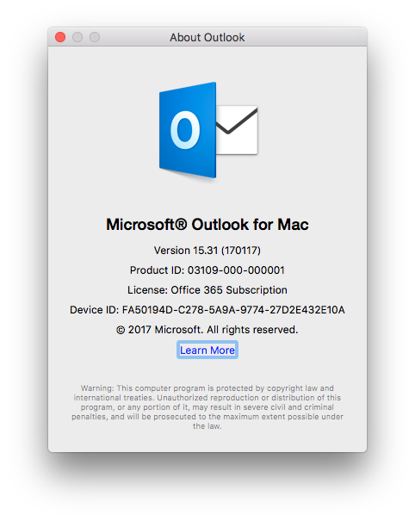
Verify Office Version
This troubleshooting is only valid on Microsoft Office 2016.
Begin by verifying the version by opening any Office application, clicking on the name of the application in the upper left (near the Apple menu), and selecting the “About …” option. You are looking for a version number of 15.20 or higher.

Slide 4
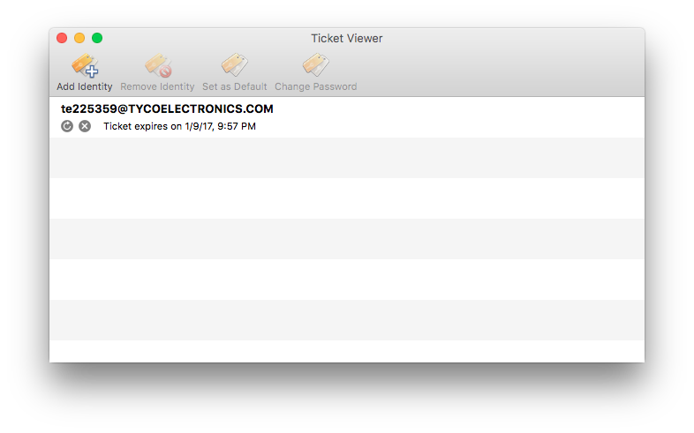
Verify Kerberos Ticket
Open a Finder window and navigate to “/System/Library/CoreServices/” (note this is NOT the user’s home folder Library, nor the Library on the root level of the drive). Locate and launch TicketViewer.
Verify that there is a valid identity present; use the Add Identity button to create one (you will need to be on the TE network). Highlight and remove any expired identities.

Slide 5
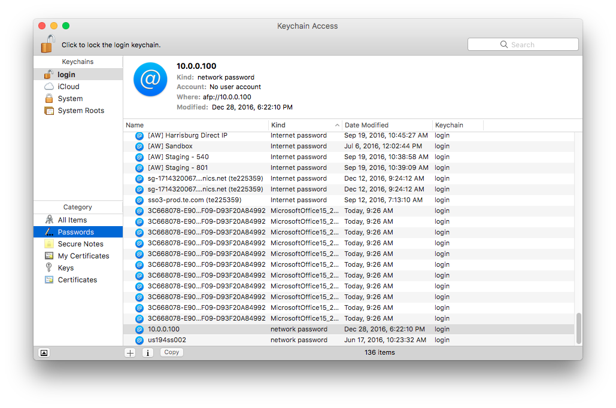
Remove Office Keychains
Be sure to quit all Office applications. In the Utilities folder in the Applications folder, launch Keychain Access. From the Keychains list in the upper left, select Login. Select Passwords from the Category list in the lower left. Sort the resulting list on the right by Kind.
Highlight and delete any entries with the kind of MicrosoftOffice15_...”.

Slide 6
Re-Activate Office
Launch Microsoft Outlook. After a few moments, you will be prompted with the same activation screen again. This is normal, as we just removed the current activation files. However, with the corrupt activation entries removed, this single activation screen should return all Office applications to full functionality.

